Slide 1
Bank Loan Case Study
By – Priyanshu Setia
Data Analytics

Slide 2
Project Description:
This Project is about analyzing loan application data and identify factors influencing loan default risks.
Datasets contains information on loan applicants, including demographics, loan details, and repayment status. The Total number of records were 50,000 with 122 columns.
Key Challenges faced:
Handling missing data and outliers.
Addressing data imbalance.
Extracting meaningful insights from complex data relationships.
Perform Univariate, Segmented Univariate, and Bivariate Analysis
Top Correlations for Different Scenarios
Illustrates the relation between various aspects like income with defaults and many more.

Slide 3
Analysis Approach:
Data Cleaning:
Handled missing values using imputation techniques.
Identified and treated outliers using IQR and box plots.
Data Exploration:
Conducted univariate, segmented univariate, and bivariate analysis.
Examined relationships between consumer and loan attributes.
Data Visualization:
Used Excel features such as pivot tables, histograms, scatter plots etc.

Slide 4

Tech-Stack Used
Microsoft Excel – Version 2021
Microsoft PowerPoint – Version 2021
Loom – For Video Presentation

Slide 5
Handling Missing Values & Data Imputation:
Columns with more than 40% of null values are dropped.
Unnecessary columns are removed that only increase the weight of the sheet.
Imputed numerical values with median or mean of the column and text values with clause “Unknown” or “NA”.

Slide 6
Columns Dropped vs Data imputed

Slide 7
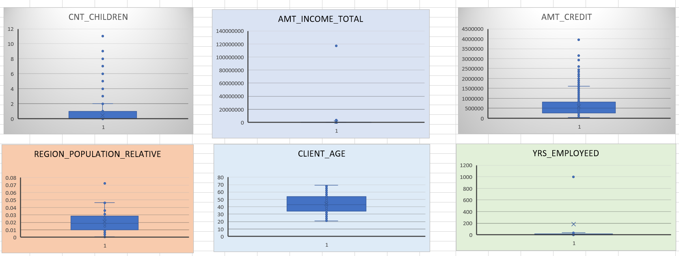
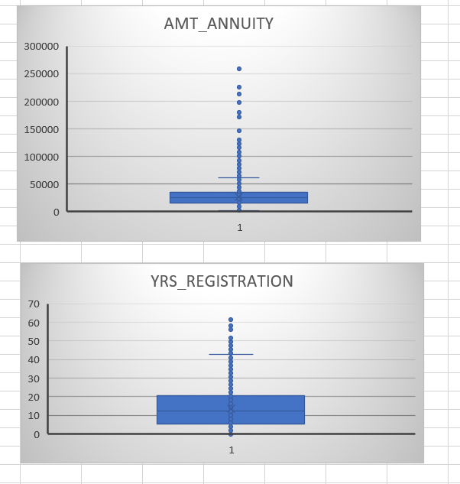
Outliners Detection & Handling
Outliers are handled using real-life scenarios and common sense. For example, in the “years_employed” field, there is an entry of someone working for 1,000 years, which is practically impossible so that field is replaced by mean of yrs-employed and so on.

Slide 8
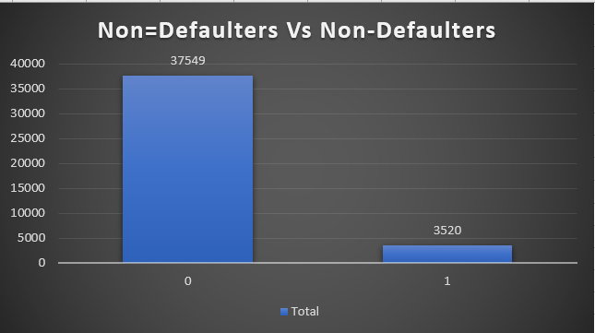
DATA IMBALANCE:
The dataset is highly imbalanced, with 91% of instances in class 0 (Non-Defaulter) and 9% in class 1 (Defaulter).
Challenge: Accurately predicting class 1 is difficult due to its low representation.

Slide 9
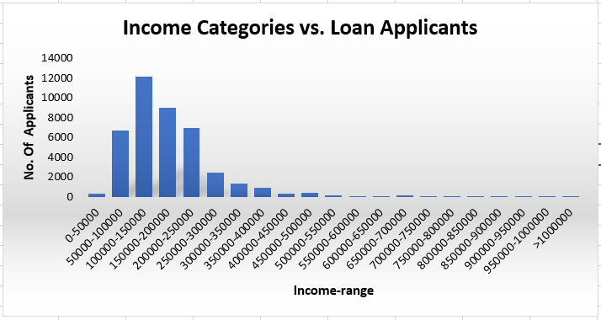
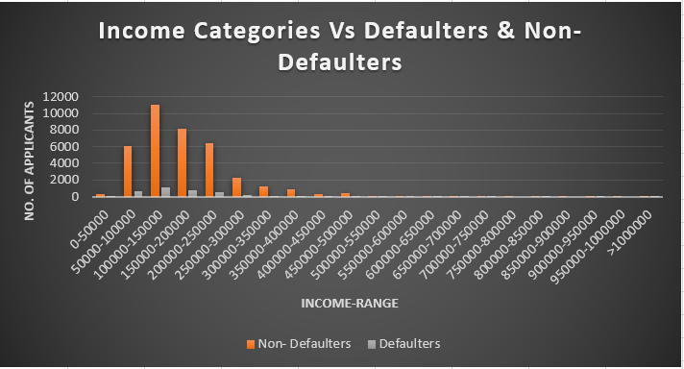
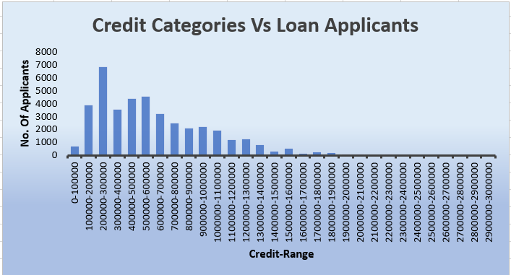
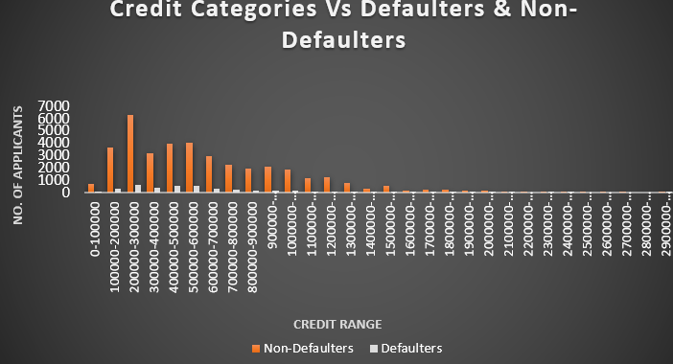
Segmented Univariate Analysis:

Slide 10
Segmented Univariate Analysis:

Slide 11
Segmented Univariate Analysis:

Slide 12
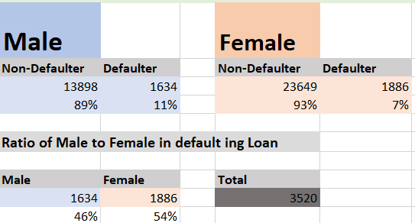
Univariate Analysis:

Slide 13
Univariate Analysis:

Slide 14
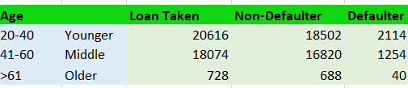
Most loan takers are aged 20-40, with fewer older borrowers.
Age should be considered in assessing loan default risk, with younger borrowers needing closer scrutiny.
The company could tailor loan terms or interest rates by age group to manage default risks.

Slide 15
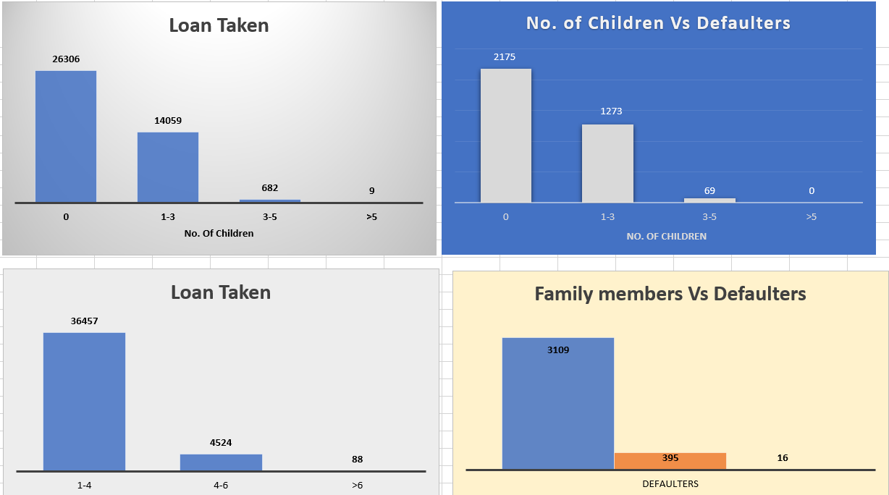
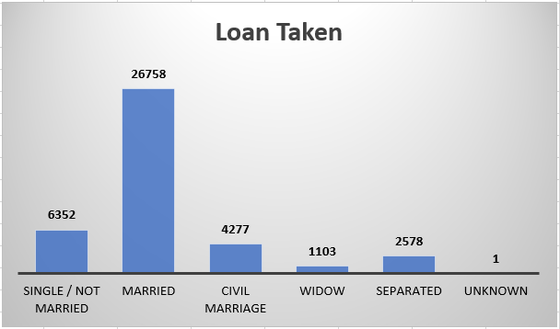
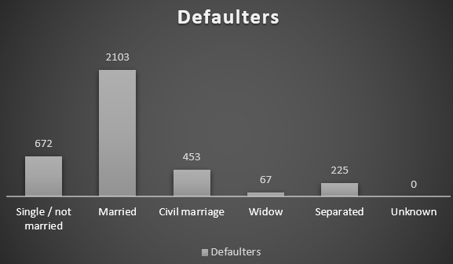
Univariate Analysis:

Slide 16
Married individuals have the highest number of loan takers.
Single individuals show a relatively lower default rate.
Widows and separated individuals have fewer defaults, indicating potentially more stable financial situations.
Larger families (>5 children) may have lower default risk, suggesting stable finances.
Smaller families (0-5 children) show higher default rates, indicating financial challenges.
Lenders might consider family size when assessing loan default risk.
Larger families (>6 members) have a higher default rate (18%), while families with 1-6 members show similar rates around 9%, indicating a correlation between family size and default risk.

Slide 17
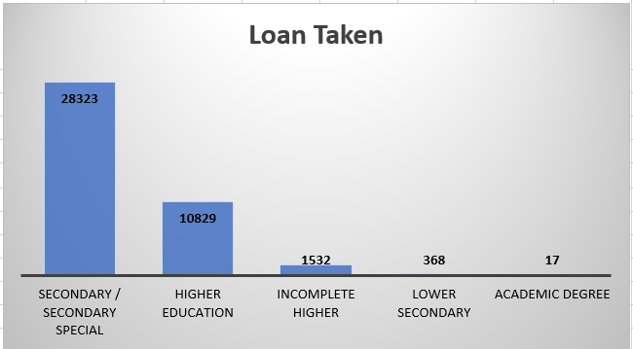
Univariate Analysis: (Education, Employment & Defaulters)

Slide 18
Borrowers with an academic degree have a 0% default rate.
"Higher education" and "Incomplete higher" categories show low default rates (5% and 9%, respectively).
Borrowers with "Secondary/secondary special" education have a higher default rate of 10%.
Education level can be a useful indicator for managing loan default risks.
Drivers, low-skill laborers, security staff, and waiters may have higher default risks.
Higher default risks in these occupations may be linked to income stability.
Job security and other occupational factors may contribute to the default risk.

Slide 19
Bivariate Analysis:

Slide 20
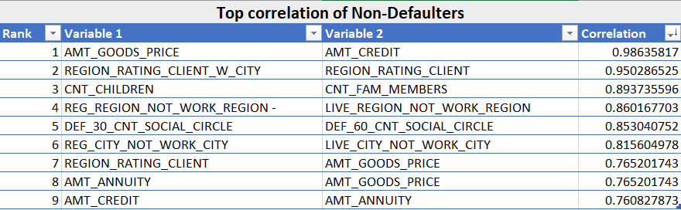
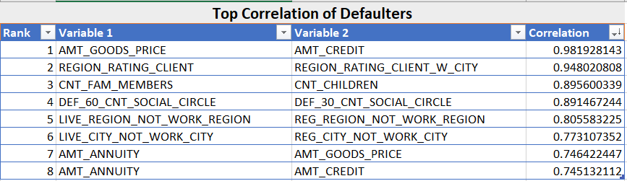
Correlation Analysis: For Different Scenarios

Slide 21
Results & Recommendations:
Focus on applicants with high Loan-to-Income ratios.
Introduce stricter eligibility criteria for applicants with inconsistent income.
Maintain complete and accurate records to reduce future data cleaning efforts.
I applied EDA to analyze data patterns in this case study.
Before starting, I researched risk analytics in banking and financial services.
I learned how data helps reduce financial risk when extending loans.
This case study improved my ability to summarize large datasets and extract insights.
I gained insights into data imbalance, outliers, and factors influencing the datasets.

Slide 22
Thank You!
Excel Workbook: Link

